Slide 1
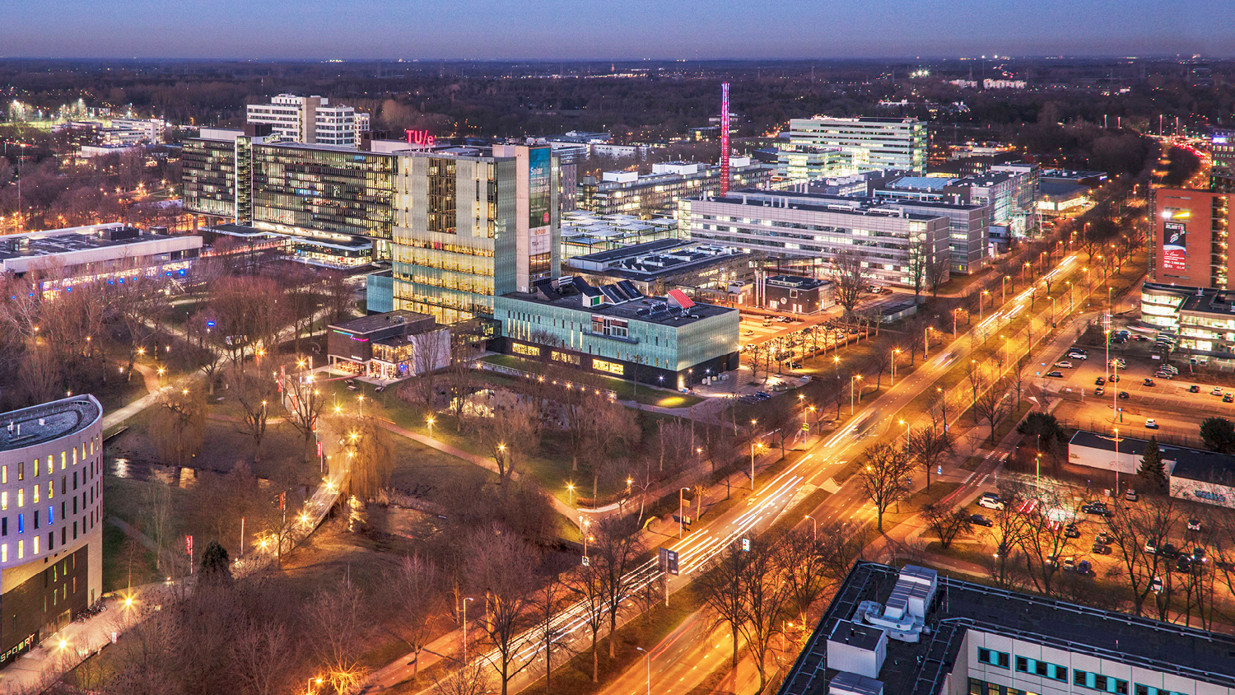
Counterfactual Inference on Retina Fundus Images using Deep Structural Causal Models
12/12/2022
Speaker: Shiqi Liao
Supervisor: Prof. Vlado Menkovski, Prof. Mitko Veta, Msc. Minartz Koen
Mathematics and Computer Science, Data Science in Engineering, Data Mining
Notes:
To generate fundus images for an individual observation conditioned on the patient attribute that is not real for him.
I want to know what my fundus image would look like when I was 80 years old.
To generate such image, we adopt the Deep Structural Causal Models

Slide 2
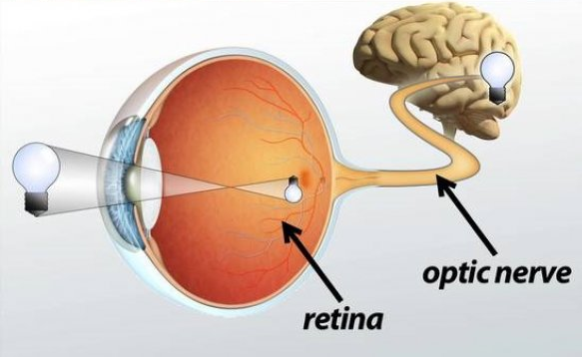
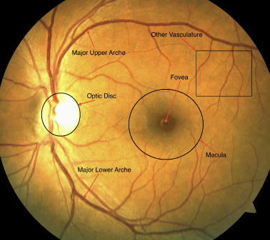
Background -> retina
Retina allows for visualization of neuronal and vascular tissue from brain
A common retina photograph, color fundus image.
Fig 1: Retain and Brain
Fig 2: An example fundus image
Notes:
Retina is a tissue layer within our eyes and connects with the brain.

Slide 3
Background -> limitations in explanation
Deep learning predicts patient attributes(gender, age, Type-2 diabetes) with fundus images
A novel method for explanation:
generate fundus images conditioned on patient attributes.
Compare the fundus images generated under different values of the same patient attribute
Deduce the relationship between the patient attributes and fundus images.

Slide 4
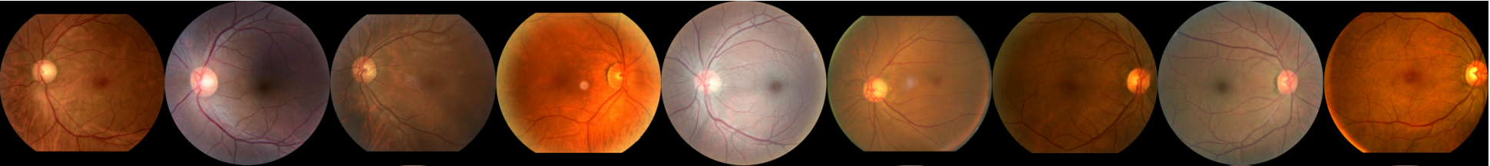
Background -> limitations in explanation
However, two limitations exist in explanation for the relation:
Confounding between patient attributes
Fundus image appearance are variant
Fig 3: Confounding example
Fig 4: variant fundus image appearance
Notes:
The confounding refers to a distorted correlation between two variables when an extra variable is correlated with both.
Older people are likely to have diabetes and vision loss. However, there is no correlation between the diabetes and vision loss. This correlation between diabetes and vision
loss does not exist in the population but only in the subpopulation of older people due to the confounder age.
Such confounding exist in the patient attributes.
So even though we generate two fundus image conditioned on different value of the same patient attribute, the difference between two fundus images can not reflect the relationships

Slide 5
Task
To generate fundus images for an individual observation conditioned on counterfactual patient attributes, aka counterfactual inference
The generative model should control the confounding and preserve the variation of fundus image for an individual.
Notes:
Contrastively retell

Slide 6
Research question
What are the causal relationship between patient attributes and fundus image?

Slide 7
Methodology -> Assumed causal DAG
Fig 5: Assumed causal DAG
Notes:
We construct a deep structural causal model to answer the research question, before we elaborate on it. Let’s look into some bases.
our assumed causal DAG. DAG is short for directed acyclic graph. We use the nodes to represent the variables and use the arrows to represent the causal relationship from the cause to the effect. In our assumption, we assume gender causes diabetes status and fundus images ….. And we can see that gender and age are two confounders on the relationship between diabetes status and fundus images.

Slide 8
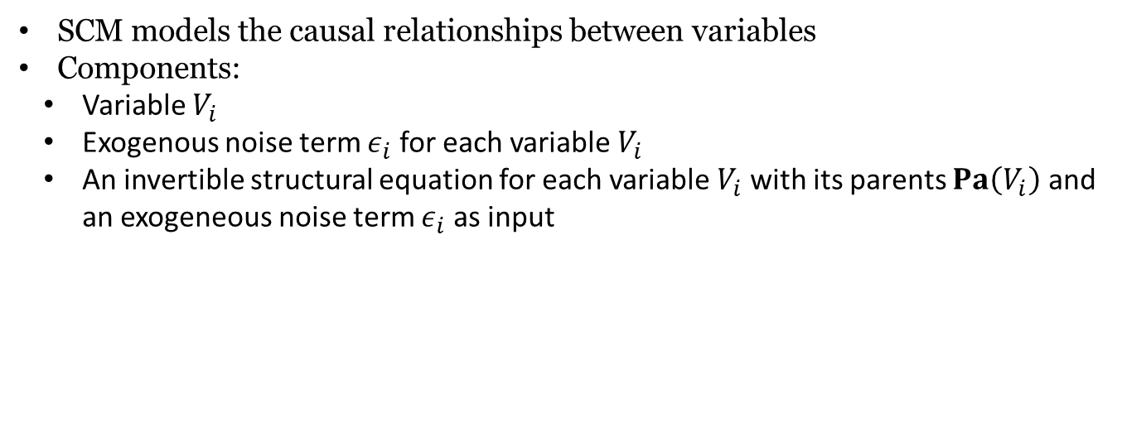
Methodology -> SCM(Structural Causal Model)
SCM models the causal relationships between variables
Components:
Variable $V_{i}$
Exogenous noise term $ε_{i}$ for each variable $V_{i}$
An invertible structural equation for each variable $V_{i}$ with its parents $Pa\left(V_{i}\right)$ and an exogeneous noise term $ε_{i}$ as input
$$V_{i}:=f_{i}\left(ε_{i};Pa\left(V_{i}\right)\right)$$
Notes:
Structural Causal Model quantify the causal relationship between variables.
It has three components.
The variables of interest in the system.
Exogenous noises for each variable.
And an invertible structural equation for each variable
We use the exogenous noises to preserve the variation of fundus image for an individual observation and use the structural equation to model the data generation given its parents.

Slide 9
Methodology -> DSCM(Deep Structural Causal Model)
Fig 9: Assumed causal DAG
Fig 10: custom DSCM
Notes:
So based on the assumed causal DAG, we design the Structural Causal Model.
We adopts deep learning to learn the structural equations. And we elaborate on them one by one.

Slide 10
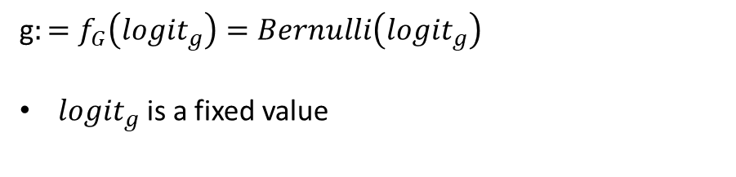
Methodology -> Gender
g$:=f_{G}\left({logit}_{g}\right)=Bernulli\left({logit}_{g}\right)$
${logit}_{g}$is a fixed value
Notes:
For gender, we assume it follows Bernoulli distribution with a fixed parameter logit_g.

Slide 11
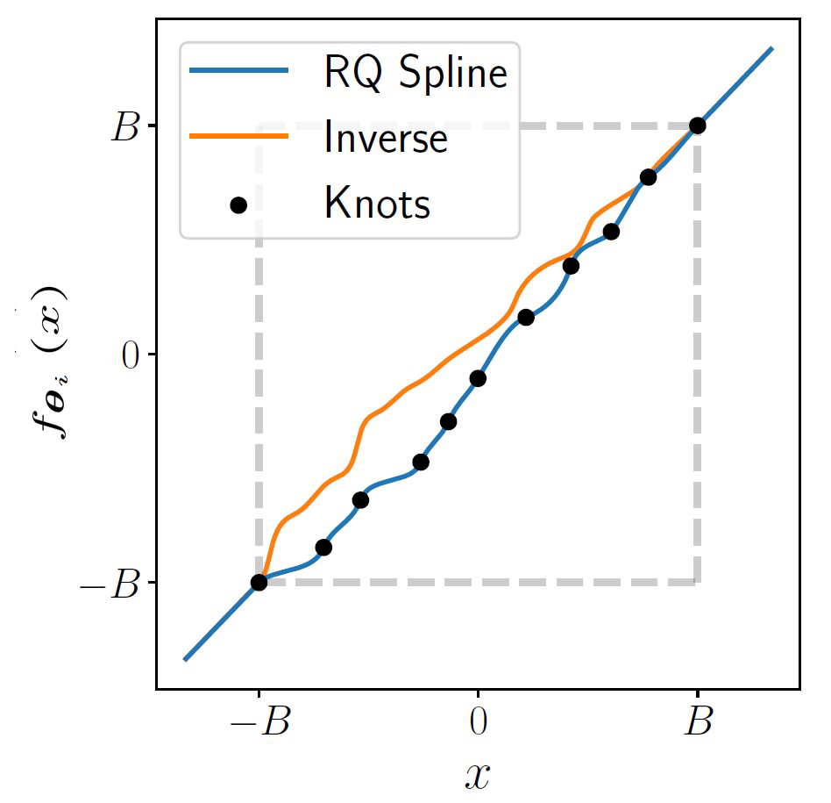
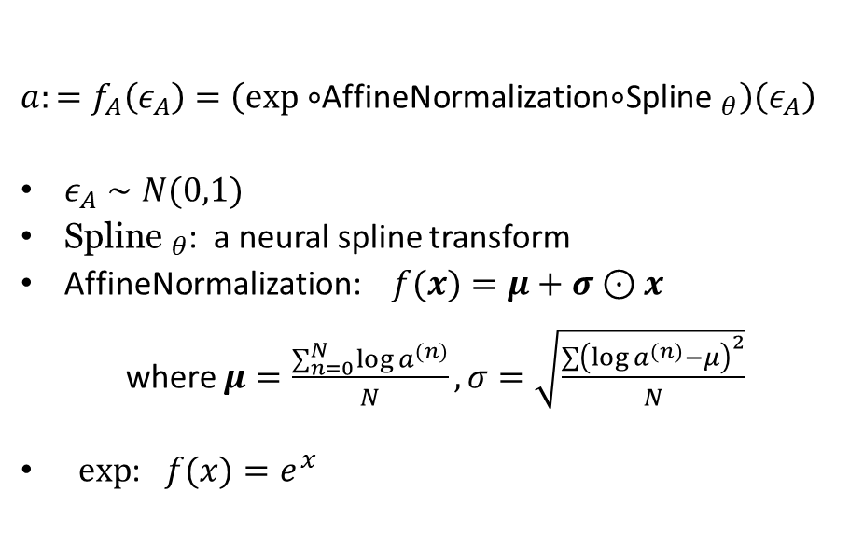
Methodology -> Age
$a:=f_{A}\left(ε_{A}\right)=\left(exp∘\right.$AffineNormalization$∘$Spline$\left. _{θ}\right)\left(ε_{A}\right)$
$ε_{A}∼N(0,1)$
${\text{Spline} }_{θ}$: a neural spline transform
AffineNormalization: $f(x)=μ+σ⊙x$
where $μ=\frac{∑_{n=0}^{N} log⁡a^{(n)}}{N},σ=\sqrt{\frac{∑{\left(log⁡a^{(n)}−μ\right)}^{2}}{N}}$
$exp$: $f(x)=e^{x}$
Fig 11: example neural spline transform
Notes:
For age, the exogenous noise follows Normal distribution. And we adopts a neural spline transform here. A neural spline transform can learn the map from a simple base distribution to a more complex target distribution. Basically, the transformation is composed of a set of continuous splines. And we optimize the transformation by optimizing the location of knots and gradients at the knots.
Back to the structural equation for age, we use the neural spline transform to map from Normal distribution to a complex intermediate distribution. Then we use the fixed affinenormalizaiton and exponential transformation to map the intermediate distribution to the distribution of age.

Slide 12
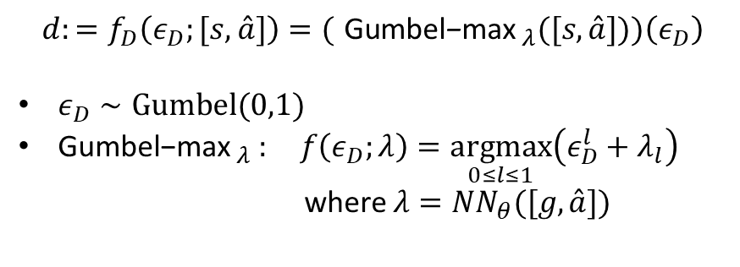
Methodology -> Diabetes status
$$d:=f_{D}\left(ε_{D};[s,\overset{ˆ}{a}]\right)=({ \text{Gumbel}\text{−}\text{max} }_{λ}([s,\overset{ˆ}{a}]))\left(ε_{D}\right)$$
$ε_{D}∼Gumbel⁡(0,1)$
${\text{Gumbel}\text{−}\text{max} }_{λ }: f\left(ε_{D};λ\right)=\underset{0≤l≤1}{argmax}\left(ε_{D}^{l}+λ_{l}\right)$
where $λ=NN_{θ}([g,\overset{ˆ}{a}])$
Notes:
For diabetes status, the exogenous noise e_d follows Gumbel distribution. And we use the Gumbel-Max distribution to approximate the distribution of diabetes status. The Gumbel-max distribution sample the argmax from the sum of the exogenous noise e_d and the conditional likelihood lambda. It is the conditional likelihood of diabetes status given its parent gender and age. We use a neural network to predict the likelihood

Slide 13
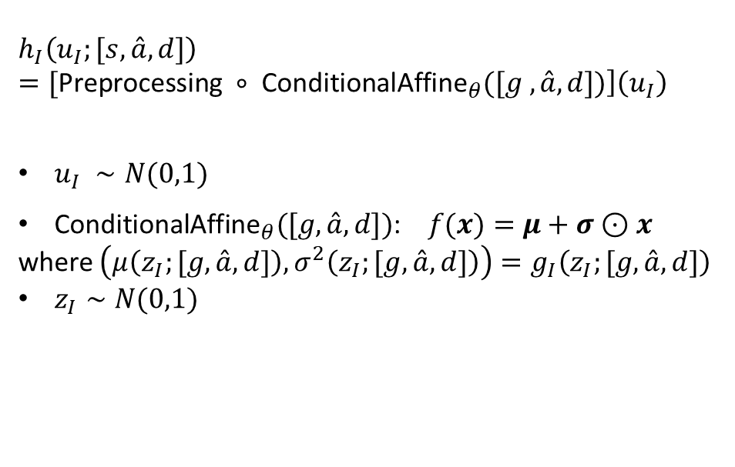
Methodology -> Image
$$h_{I}\left(u_{I};[s,\overset{ˆ}{a},d]\right)=[\text{Preprocessing} ∘ \left.{\text{ConditionalAffine}}_{θ}([g ,\overset{ˆ}{a},d])\right]\left(u_{I}\right)$$
$u_{I} ∼N(0,1)$
${\text{ConditionalAffine}}_{θ}([g,\overset{ˆ}{a},d])$: $f(x)=μ+σ⊙x$
where $\left(μ\left(z_{I};[g,\overset{ˆ}{a},d]\right),σ^{2}\left(z_{I};[g,\overset{ˆ}{a},d]\right)\right)=g_{I}\left(z_{I};[g,\overset{ˆ}{a},d]\right)$
$z_{I}∼N(0,1)$
Notes:
For high dimensional data, fundus image, we adopt a structural equation combing a shallow affine transform $h_{I}$ and a deep variational autoencoder $e_{I}$ and $g_{I}$. It has two exogenous noises $u_{I}$and $z_{I}$. In the shallow affine transform $h_{I}$, we map the fundus image to the exogenous noises $u_{I}$of the same dimension
Via an affine transformation. And the parameters $μ+σ$(mu and sigma) is predicted by a decoder $g_{I}$ with the input of the patient attributes and another exogenous noise $z_{I}$. The exogenous noises $z_{I}$ also follows the normal distribution. Recall that the structural equation should be invertible. We can map from the exogenous noises to the fundus image so far but can not map from the fundus image to the exogenous noises. So we introduce an encoder $e_{I}$ to variationally infer the exogenous noise $z_{I}$. We set the exogenous noise $z_{I}$ to a low dimension and expect it to encode the high-level structure of the fundus images.

Slide 14
Methodology -> Counterfactual inference
Three necessary steps:
Abduction: infer the exogenous noise based on an individual observation via inverted structural equations.
Action: modify the deep structural equations by reassigning it to a deterministic value
Prediction: generate the fundus images by recomputing the value of variables based on the exogenous noises and the modified deep structural equations.
Notes:
Based on the custom DSCM, we can make counterfactual inference. It includes three steps, abduction, action and prediction. In abduction, we infer the exogenous noise based on an individual observation via the inverted structural equations. Then in action, we modify the deep structural equations by reassigning it to a deterministic value. With these two steps, we get the exogenous that preserves the variation of fundus images for an individual. And we get a modified structural equations that controls the confounding and models the causation from the modified variable toward the fundus images. Finally, we generate the fundus images by recomputing the value of variables based on the exogenous noises and the modified deep structural equations.

Slide 15
Methodology -> Counterfactual inference
Abduction: infer the exogenous noise based on an individual observation via inverted structural equations.
Fig 12: abduction
Notes:
Concretely in the custom DSCM, abduction we the inverted structural equation to infer the exogenous noise in yellow. Note specifically for exogenous noise z_i, we use an encoder to varitiaonlly infer it.

Slide 16
Methodology -> Counterfactual inference
Action: modify the deep structural equations by reassigning it to a deterministic value
Fig 13: causal DAG after action
Fig 14: action
Notes:
Action, for example, to research on the causal relationship between diabetes status and fundus images. So we reassign a deterministic value to the structural equation for the diabetes status. From the modified causal DAG, we can see that the causal relationship between diabetes status and fundus images is no longer influenced by the confounders gender and age.

Slide 17
Methodology -> Counterfactual inference
Prediction: generate the fundus images by recomputing the value of variables based on the exogenous noises and the modified deep structural equations.
Fig 15: prediction
Notes:
Prediction, we follow the structural equations mapping from the exogenous noises to the variables to recompute the value of the variables.

Slide 18
Experiment and results -> Dataset
Dataset | Image Number | Participant Number
Train | 13001 | 1796
Validation | 2976 | 409
Test | 5923 | 819
Patient Attributes
Gender
Diabetes status
Age range[40, 80]
Fundus Image
Notes:
We use the Maastricht Dataset and random split it into train, validation, and test set. Each observation have gender, diabetes status, age and fundus image. The age ranges from 40 years old to 80 years old.

Slide 19
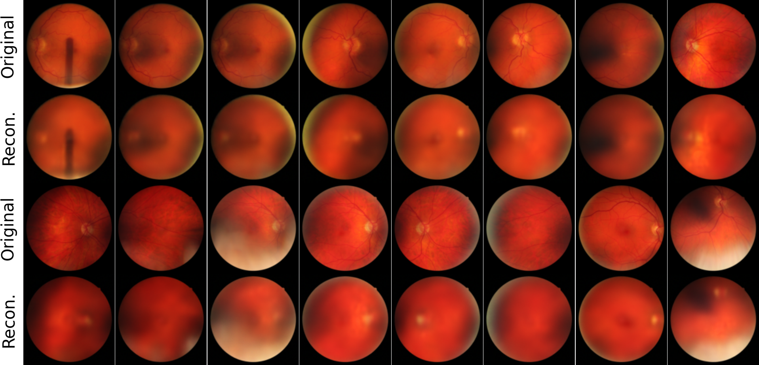
Experiment and results -> Image Reconstruction
The reconstructed images indicate the goodness of the exogenous noise $z_{I}$
Fig 20: Image reconstruction
Fig 19: Reconstructed fundus image
Notes:
Then let’s move to the experiment results. Firstly, we evaluate the representation of the exogenous noise z_I by image reconstruction. As shown in the workflow at bottom right, we variationally infer the exogenous noise z_I, sample u_i from Normal distribution and generate the fundus images based on these two exogenous noises.
Compare the original and the reconstructed fundus images, we see that the reconstructed images are blurry overall and preserve the color, optic disc, while losing the anatomical structure like vessels, background texture.

Slide 20
Experiment and results -> Counterfactual inference
Generate fundus images for an individual observation conditioned on counterfactual patient attributes
Notes:
Then we make counterfactual inference on the fundus image for an individual observation

Slide 21
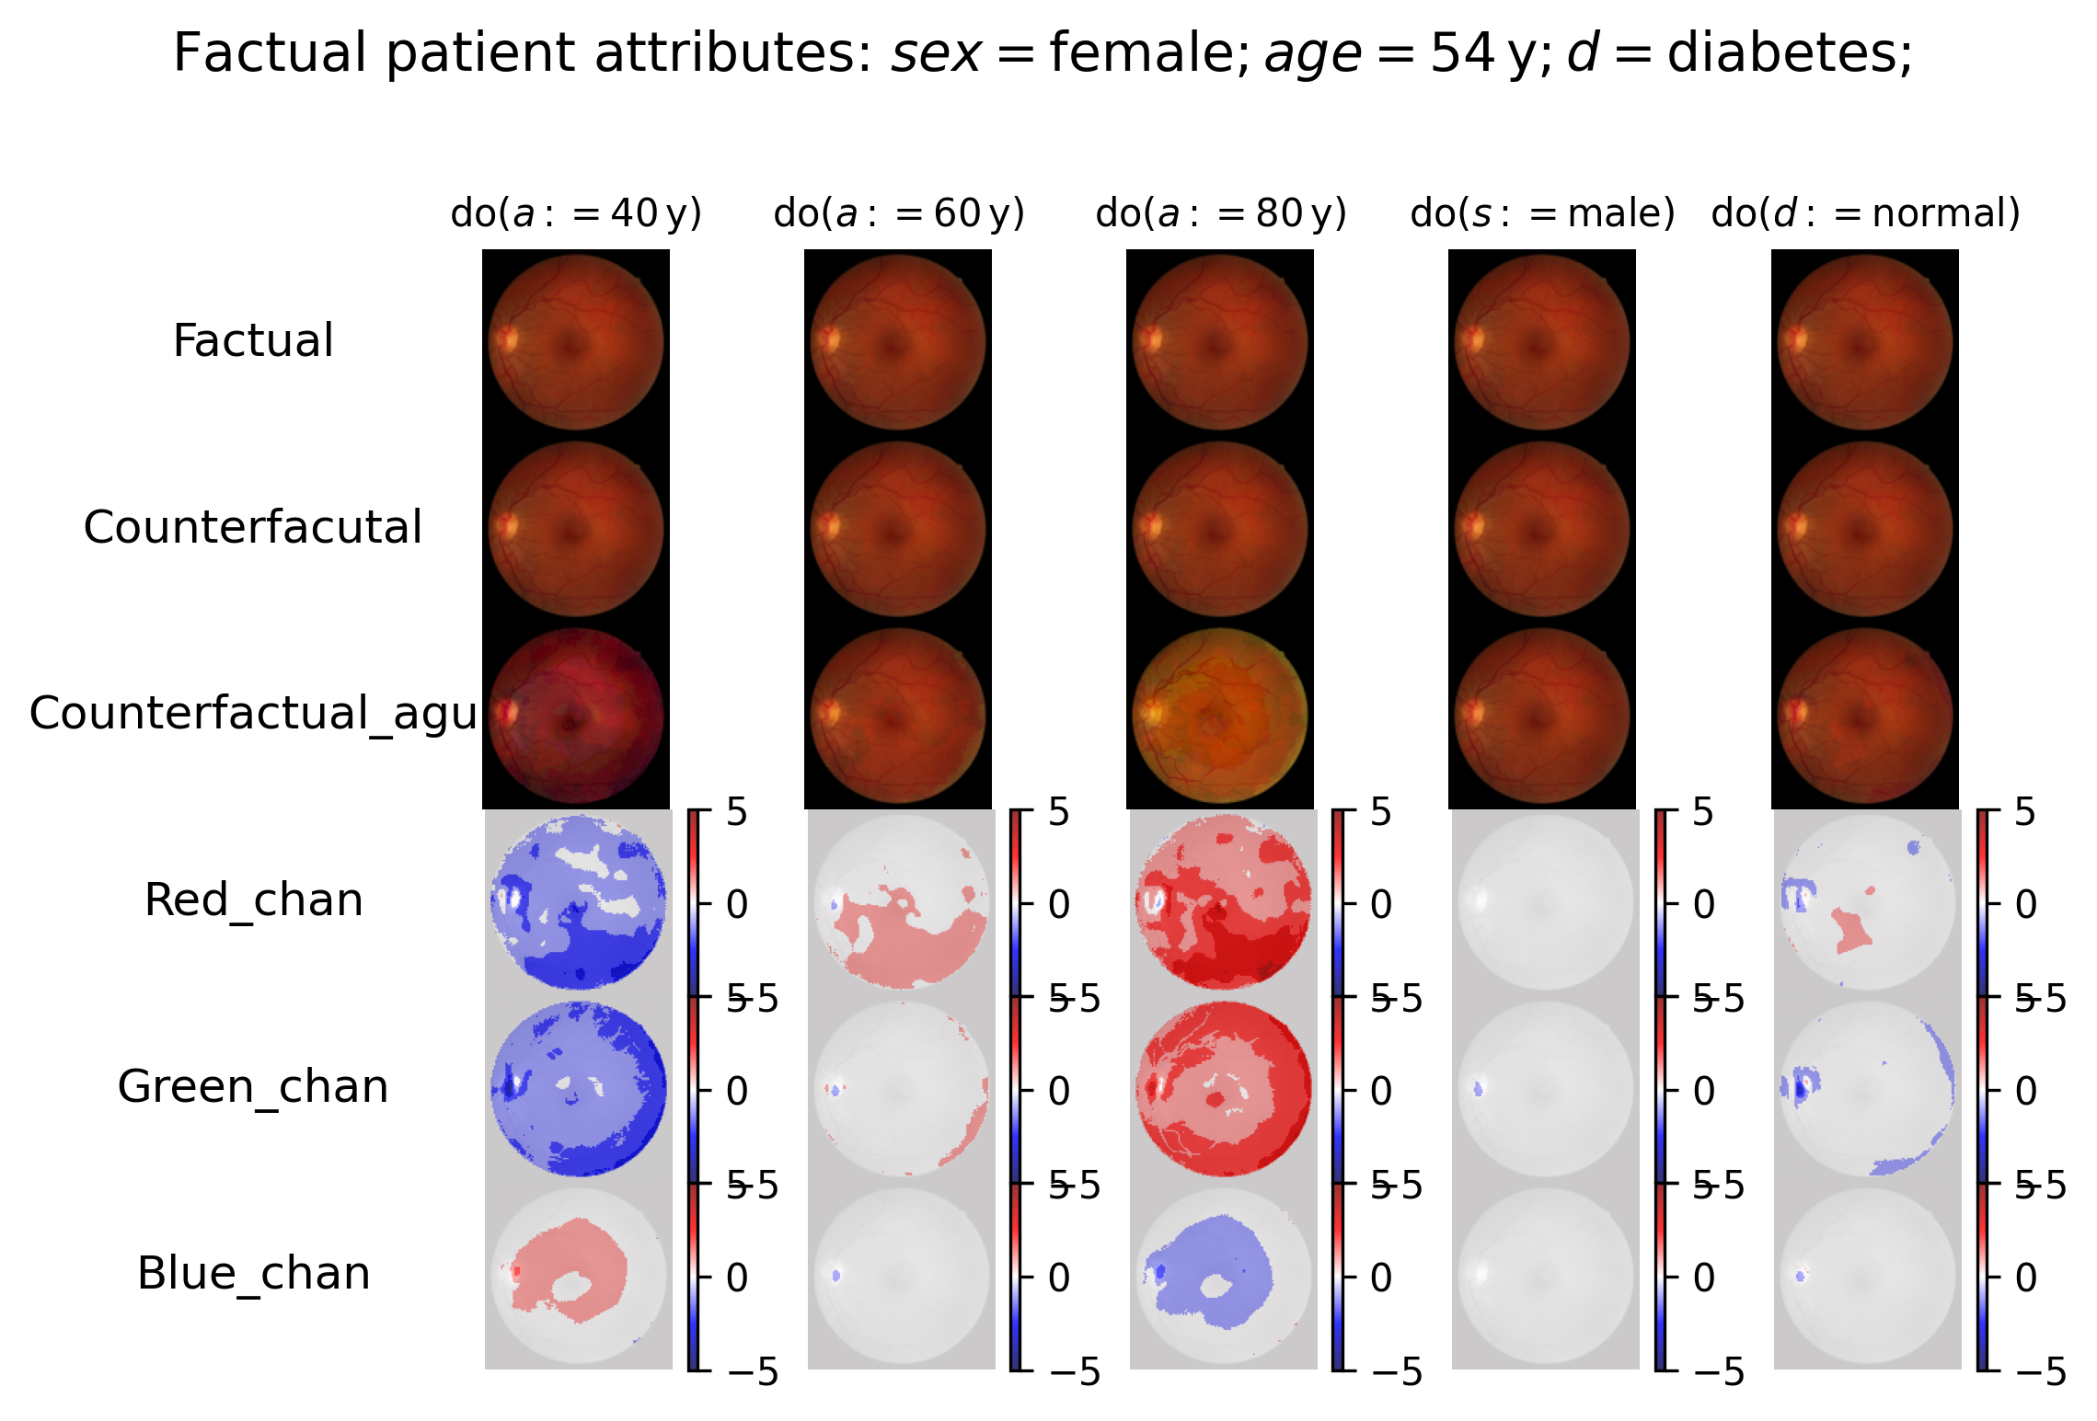
Fig 32: Counterfactual inference on an individual
Notes:
The patient is a 54 years old female with type-2 diabetes. We research on the causal relationship between age and fundus image by reassigning the age to 40 years old, 60 years old, and 80 years old.
For the causal relationship between gender and fundus image, we reassign the gender to opposite male. For the causal relationship between diabetes status and fundus image, we reassign the diabetes status to opposite normal.
The first row is the factual fundus image, the second row is the counterfactual inferred fundus image. As the difference is slight, I augment the counterfactual inferred fundus image by multiplying the difference by 15 and add back to the factual fundus image in the third row. And we plot the heatmap of the difference per RGB channel in the last three rows.
As we can see. The generated fundus image is more red under younger age and is more yellow under older age. This is because the pixel value on red and green channel is increasing and pixel value on blue channel is decreasing as the age increases. We can say aging causes the fundus image to be slightly yellow. However, the generated funds images under counterfactual condition gender and diabetes don’t have significant changes.

Slide 22
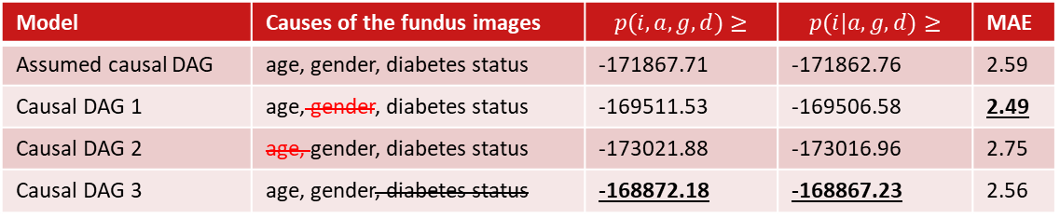
Experiment and results -> Sensitivity Analysis
Compare DSCMs based on alternative causal DAGs
Fig 36: Alternative causal DAG 1
Fig 37: Alternative causal DAG 2
Fig 38: Alternative causal DAG 3
Model | Causes of the fundus images | $$p(i,a,g,d)≥$$ | $$p(i|a,g,d)≥$$ | MAE
Assumed causal DAG | age, gender, diabetes status | -171867.71 | -171862.76 | 2.59
Causal DAG 1 | age, gender, diabetes status | -169511.53 | -169506.58 | 2.49
Causal DAG 2 | age, gender, diabetes status | -173021.88 | -173016.96 | 2.75
Causal DAG 3 | age, gender, diabetes status | -168872.18 | -168867.23 | 2.56
Notes:
To explore why we cannot make reasonable counterfactual inference on gender and diabetes status, we implement a sensitivity analysis on the assumed causa DAG.
We change the assumption on the causes of the fundus images and compare its evidence lower bound log likelihood and mean absolute error per pixel. We can see the alternative causal DAGs in the above. The bold ones are the best record. We can see that drop gender or diabetes status from cause of the fundus images improve the performance while drop age from cause of the fundus images degrades the performance.
We give our explanation. The expressive ness of our custom DSCM is limited to color. And age has a causal effect on the fundus images color while gender and diabetes status have a causal effect more on the anatomical structure of the fundus images.
So exclusion of gender or diabetes status improve the performance while exclusion of age degrades the performance.

Slide 23
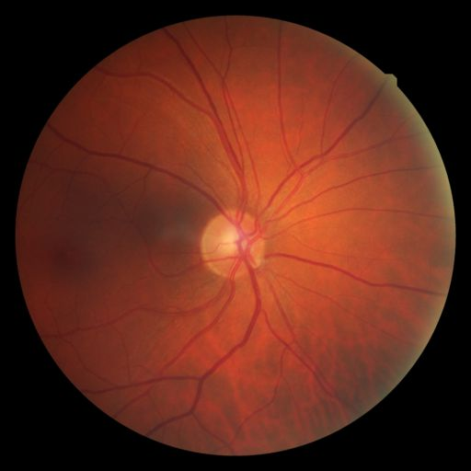
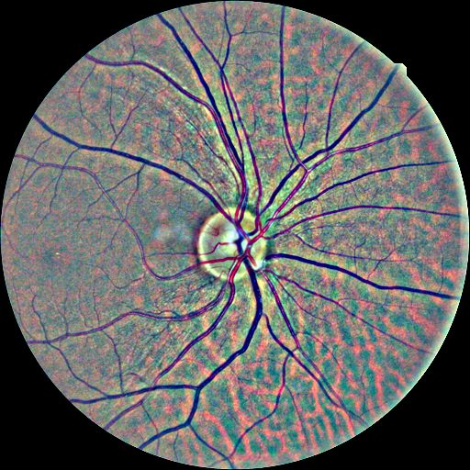
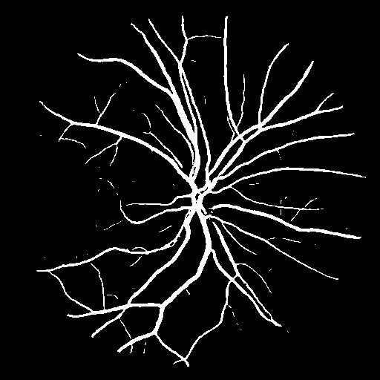
Experiment and results -> Image preprocessing
Increase the expressiveness of the DSCM on the fundus images on anatomical structures and then apply it to counterfactual inference
Fig 16: original fundus image
Fig 17: contrast-normalized fundus image
Fig 18: vessel mask of fundus image
Notes:
To improve the expressiveness of our custom DSCM on the anatomical structure. We train the DSCM on preprocessed fundus images.
The contrast-normalized fundus images highlight the vessel and optic disc. And the vessel mask highlights the vessel shape.

Slide 24
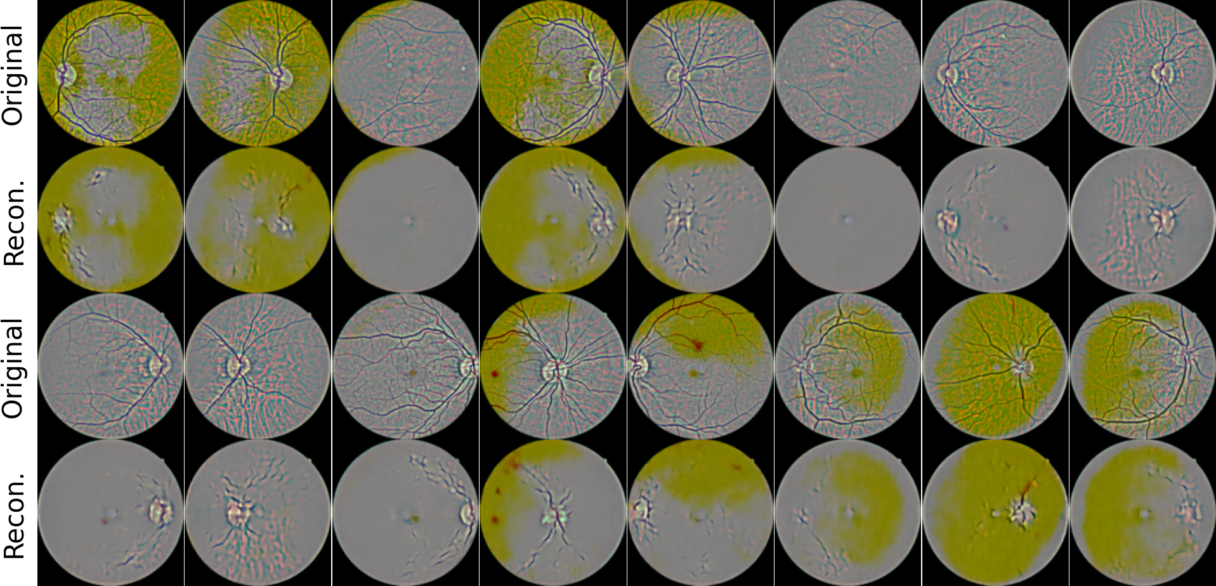
Experiment and results -> Image preprocessing
Contrast normalized fundus images
Fig 39: Reconstructed contrast normalized fundus image
Notes:
For the contrast normalized fundus images, the reconstructed images preserve the optic disc and truncated vessels from the optic disc.

Slide 25
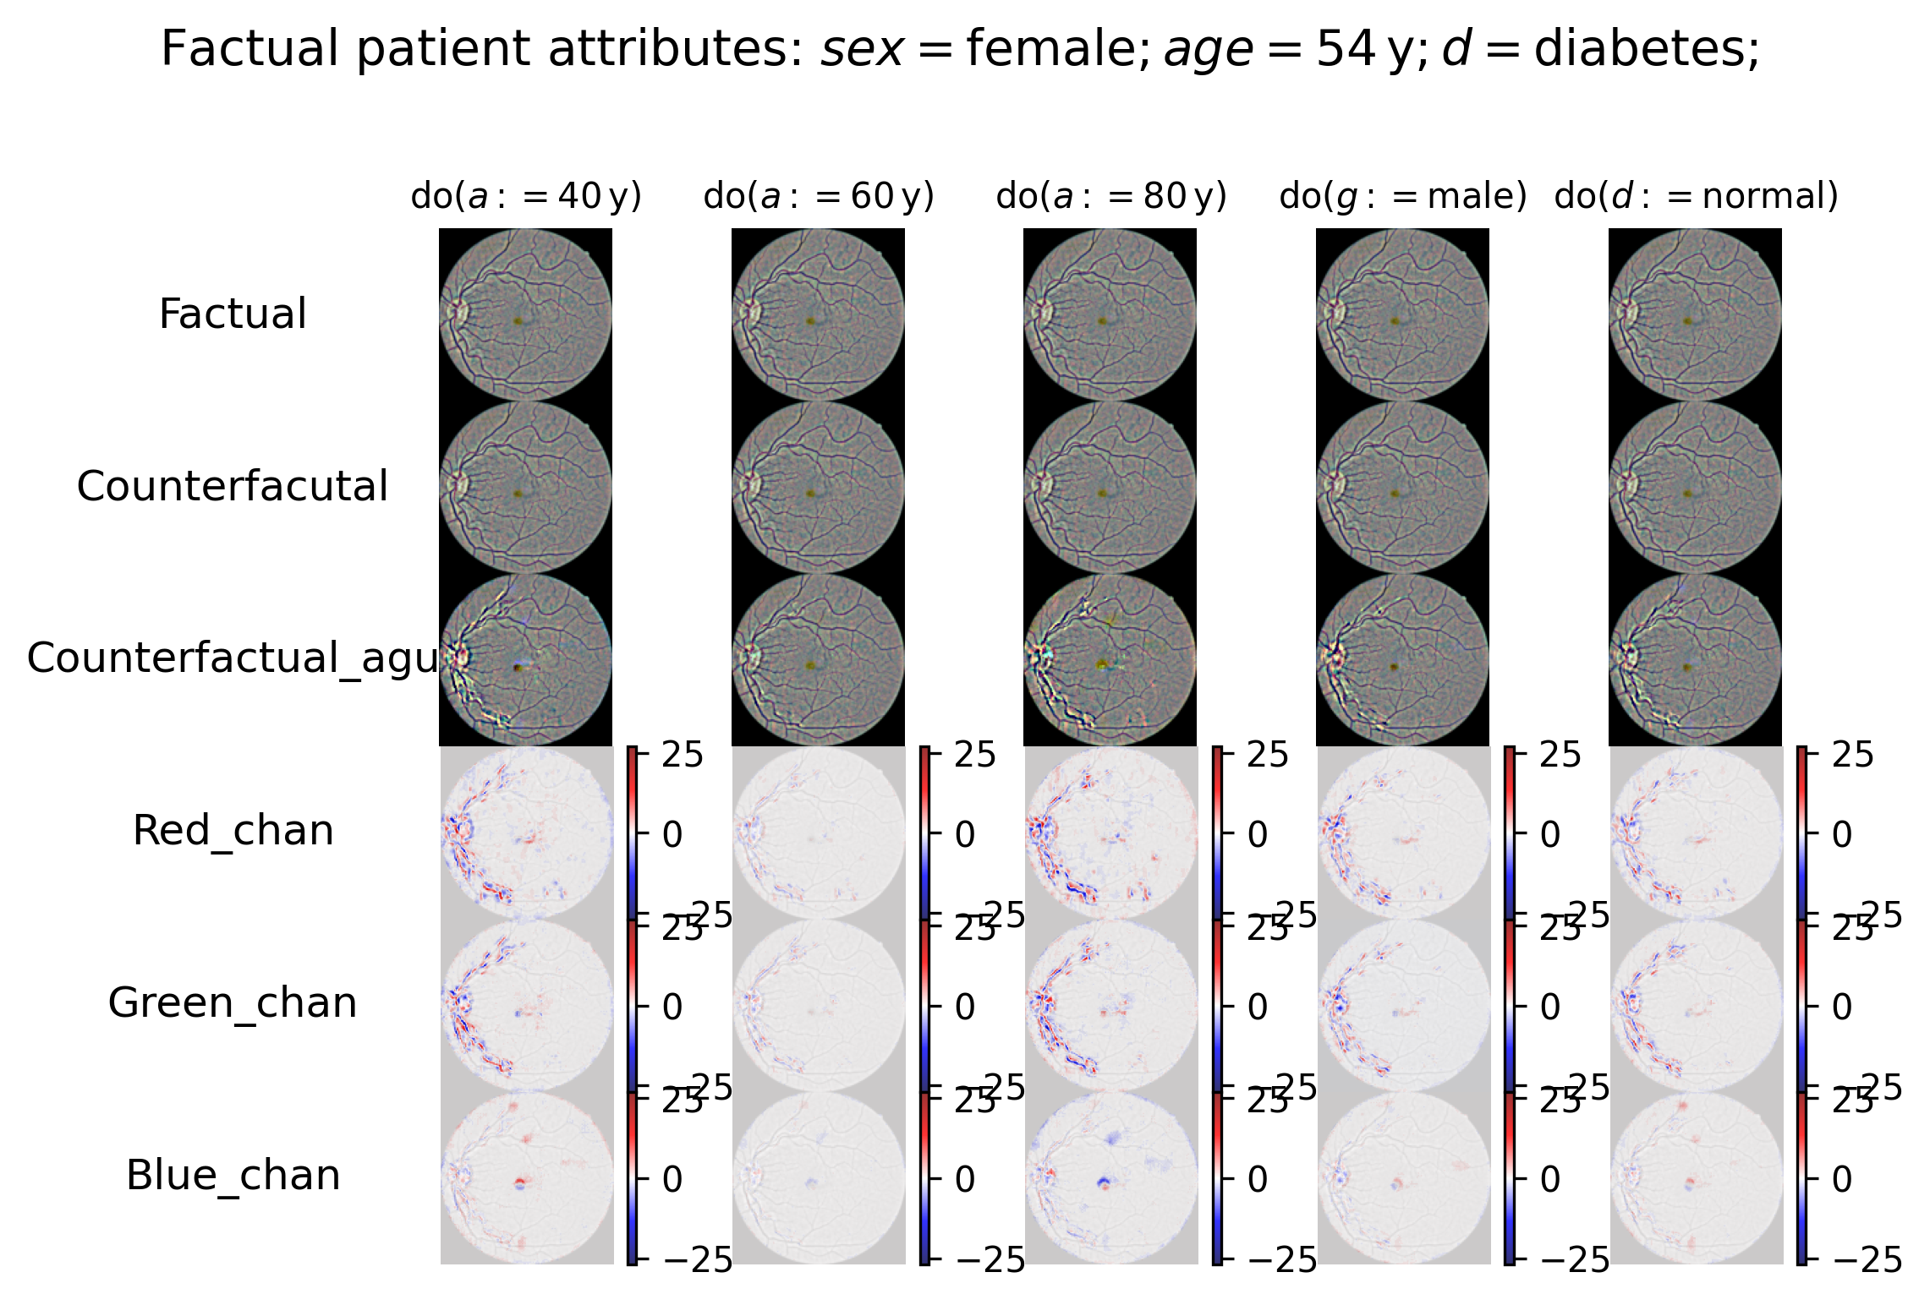
Fig 41: Counterfactual inference on normalized fundus images
Notes:
The counterfactual inferred images have enhanced contrast around the optic disc and the vessel trunk under any counterfactual condition. And they do not show any reasonable and informative change patterns.

Slide 26
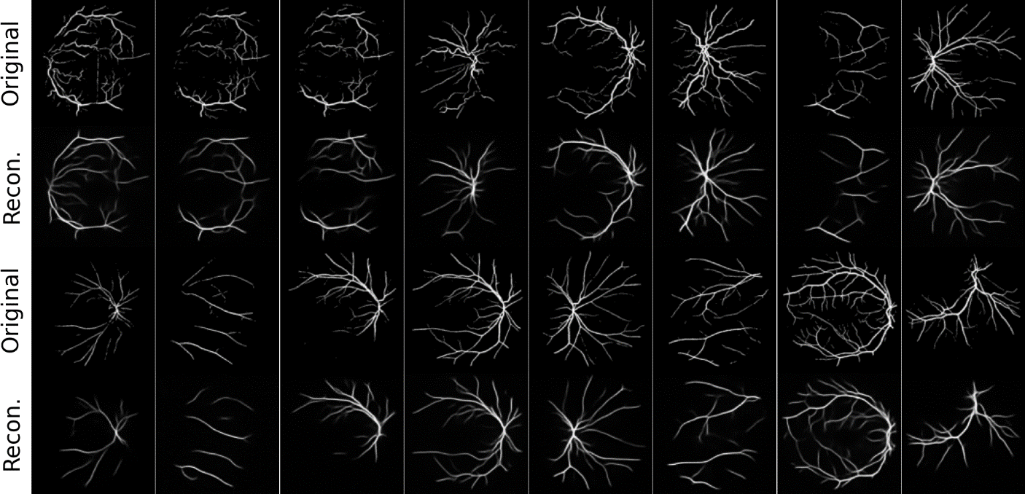
Experiment and results -> Image preprocessing
Vessel mask of fundus images
Fig 42: Reconstructed vessel mask of fundus image
Notes:
For the vessel mask of the fundus images, the reconstructed images preserve the shape of the vessel trunk and lose the tiny vessel branch.

Slide 27
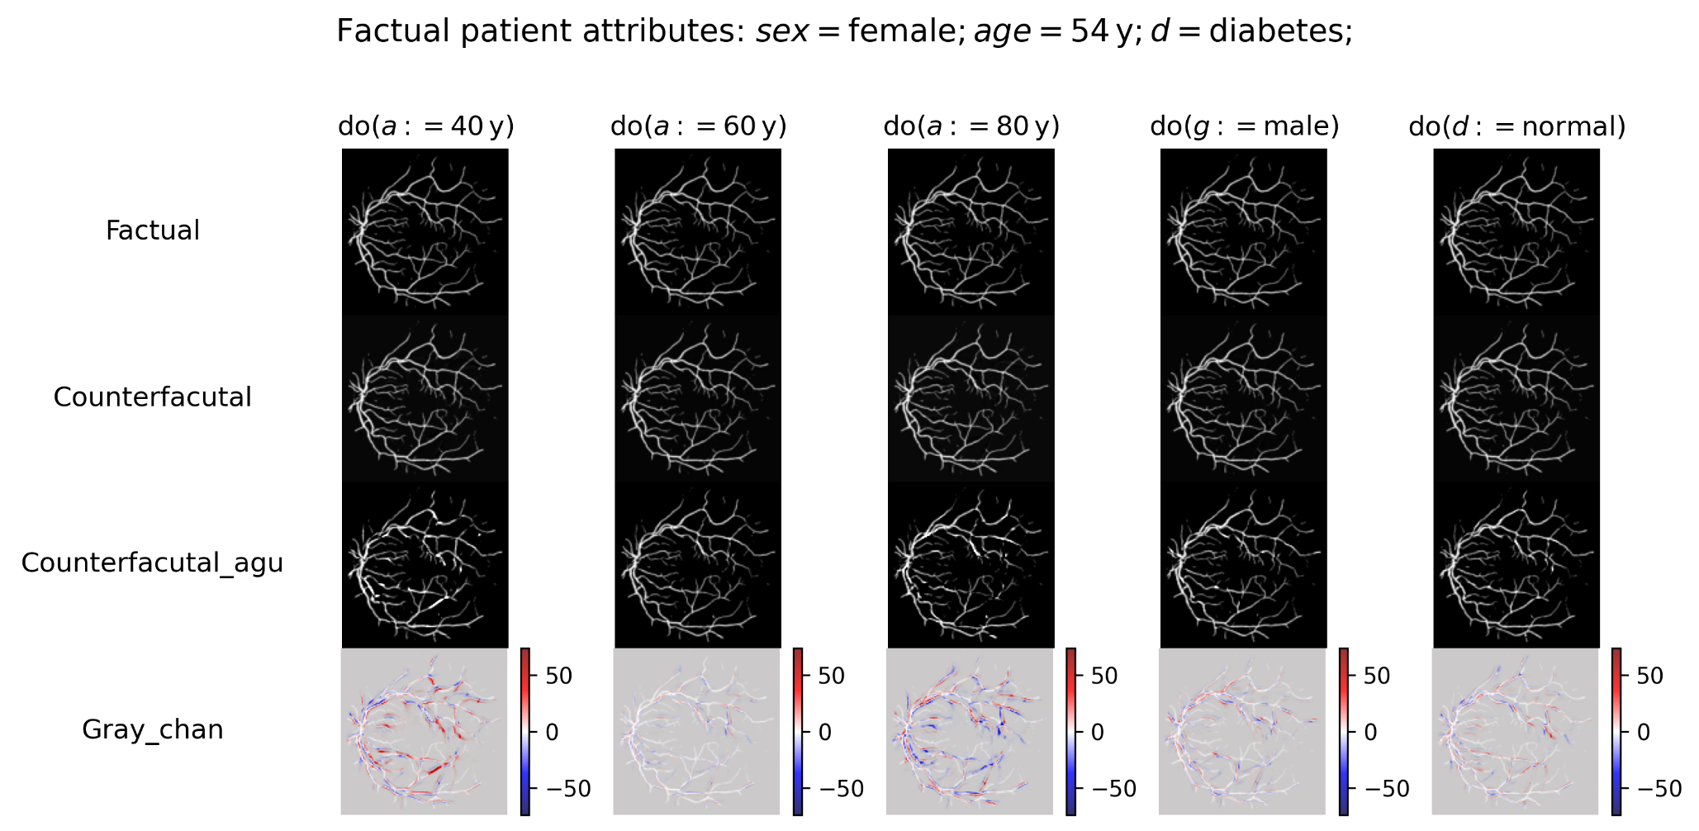
Fig 43: Counterfactual inference on vessel mask of fundus images
Notes:
The counterfactual inferred images have partially enhanced and partially degraded vessel trunk under any counterfactual condition. And they do not show any reasonable and informative change patterns.

Slide 28
Conclusion
The custom DSCM has limited expressiveness on the fundus image color. As a result, it can generate reasonable fundus images under counterfactual age but not under counterfactual gender and diabetes status.
Our finding that aging causes the fundus images to be slightly more yellow can be used to explain the black box in the neural networks to predict age with the fundus images.
Highlighting the anatomical structure of fundus images can improve the expressiveness of the DSCM, but not enough to make counterfactual inference
Notes:
Based on the experiment results, we make our conclusion.

Slide 29
THE END
Thank you for watching
Shiqi Liao
Mathematics and Computer Science, Data Science in Engineering, Data Mining

Slide 30
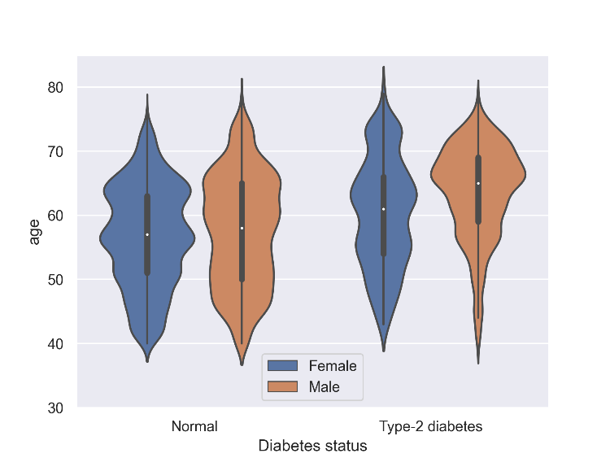
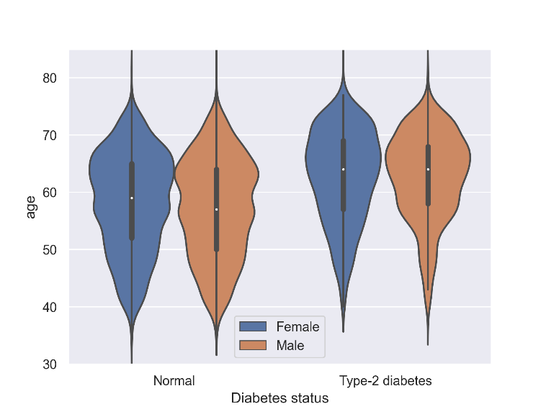
Experiment and results -> Associational inference
Model the joint distribution based on the statistical dependence in the observational data
Fig 26: Joint distribution $p(a,g,d)$ in training data
Fig 27: Joint distribution $p(a,g,d)$ modeled by DSCM
Notes:
000046220120416010001.tiff

Slide 31
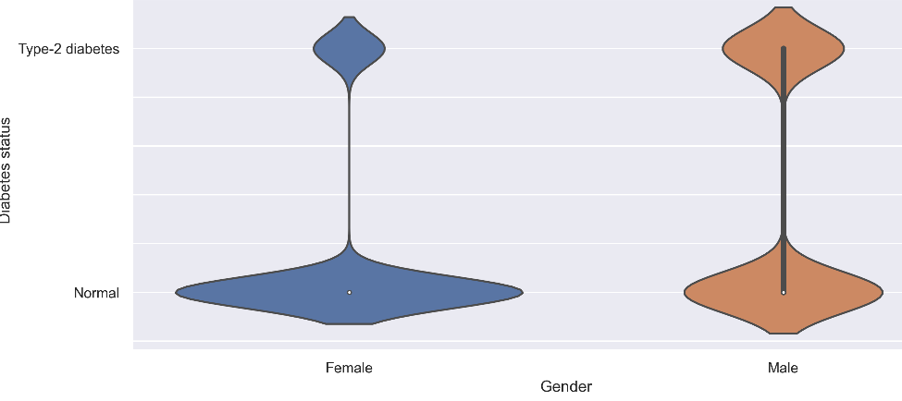
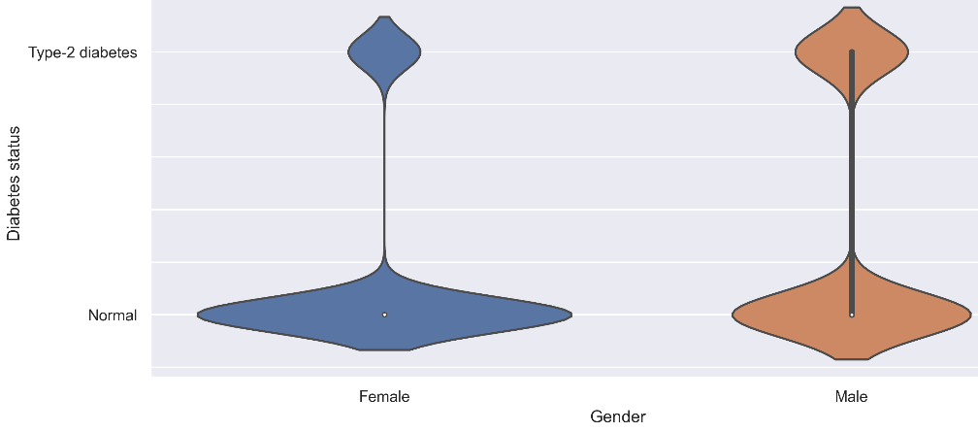
Experiment and results -> Associational inference
Model the joint distribution based on the statistical dependence in the observational data
Fig 20: Joint distribution $p(g,d)$ in training data
Fig 21: Joint distribution $p(g,d)$ modeled by DSCM
Notes:
000046220120416010001.tiff

Slide 32
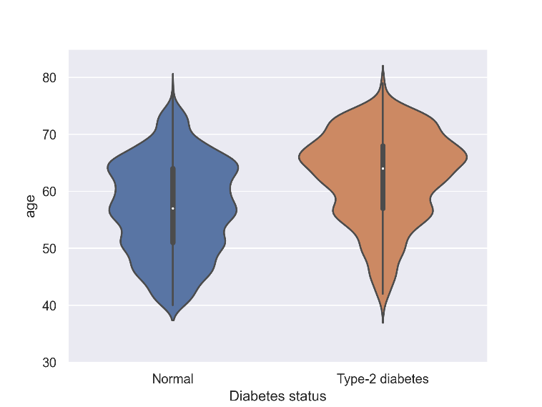
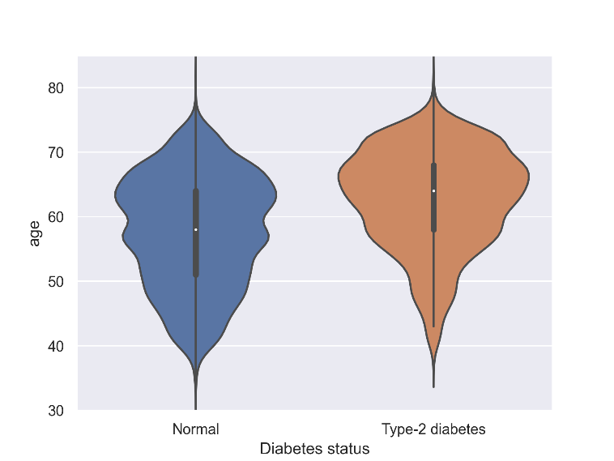
Experiment and results -> Associational inference
Model the joint distribution based on the statistical dependence in the observational data
Fig 22: Joint distribution $p(a,d)$ in training data
Fig 23: Joint distribution $p(a,d)$ modeled by DSCM
Notes:
000046220120416010001.tiff

Slide 33
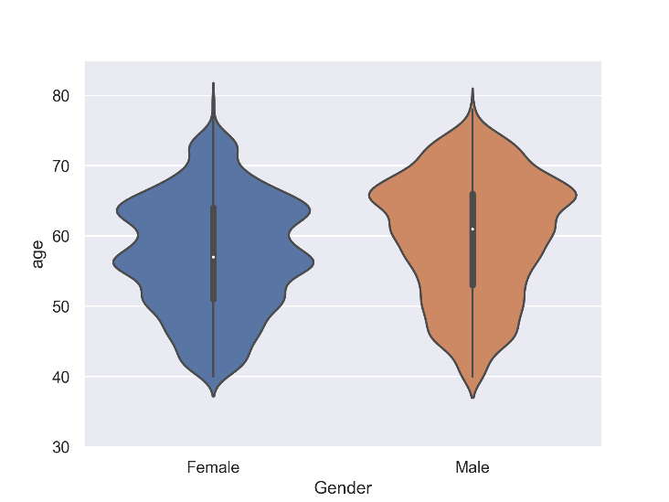
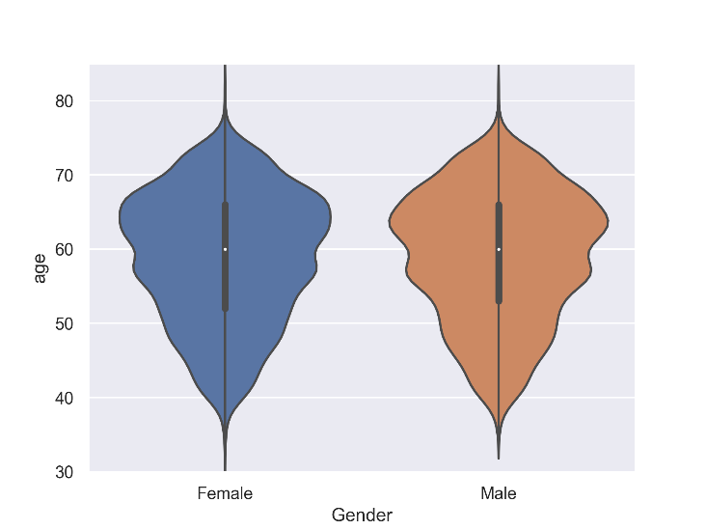
Experiment and results -> Associational inference
Model the joint distribution based on the statistical dependence in the observational data
Fig 24: Joint distribution $p(a,g)$ in training data
Fig 25: Joint distribution $p(a,g)$ modeled by DSCM
Notes:
000046220120416010001.tiff

Slide 34
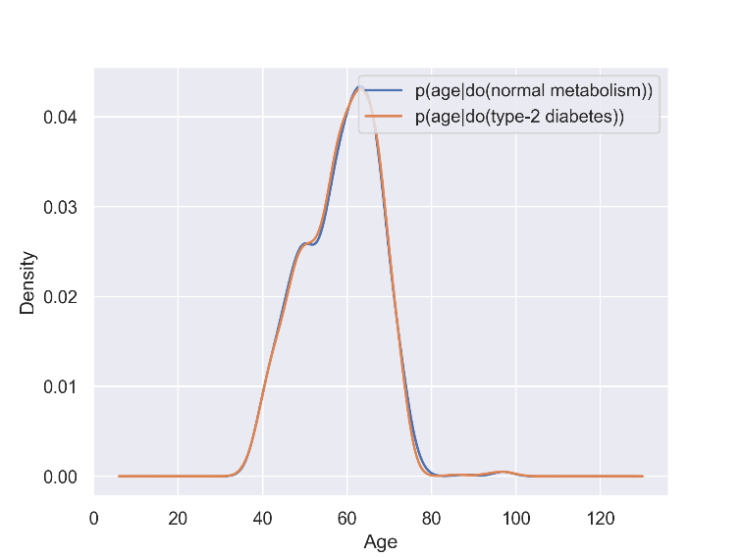
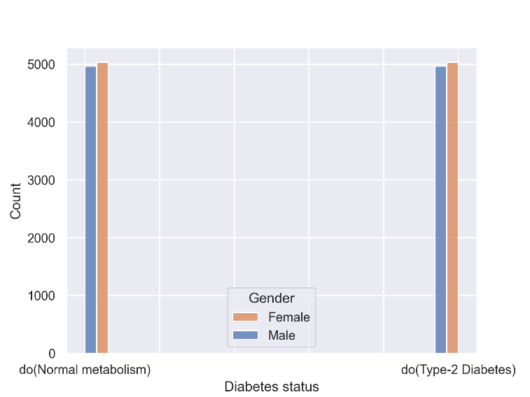
Experiment and results -> Interventional inference
Model the causation by intervening on the causal DAG.
Fig 28: Interventional distribution of age $p(a∣do(d))$
Fig 29: Interventional distribution of gender $p(g∣do(d))$
Notes:
000046220120416010001.tiff

Slide 35
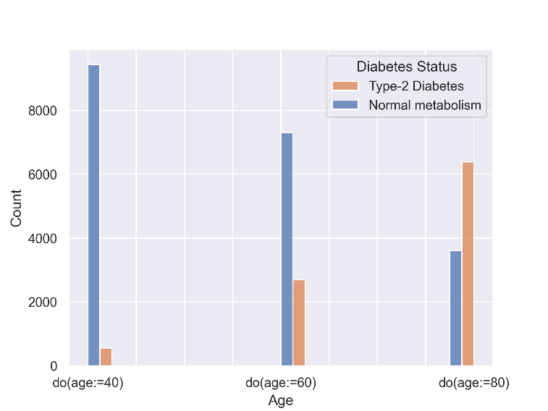
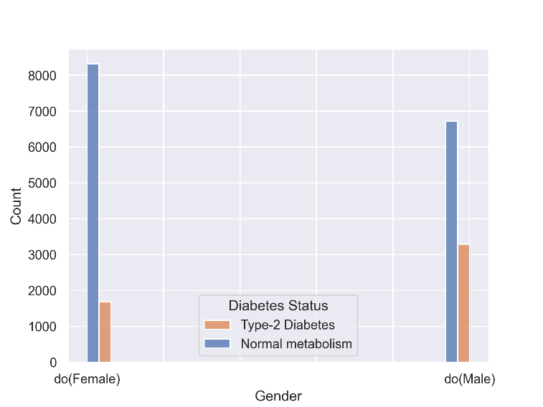
Experiment and results -> Interventional inference
Model the causation by intervening on the causal DAG.
Fig 30: Interventional distribution of age $p(d∣do(a))$
Fig 31: Interventional distribution of gender $p(d∣do(g))$
Notes:
000046220120416010001.tiff

Slide 36
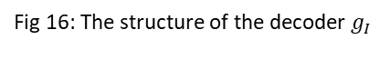
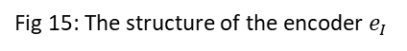
Methodology -> Image
Fig 15: The structure of the encoder $e_{I}$
Fig 16: The structure of the decoder${ g}_{I}$

Slide 37
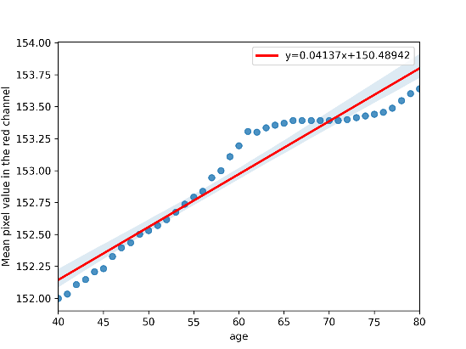
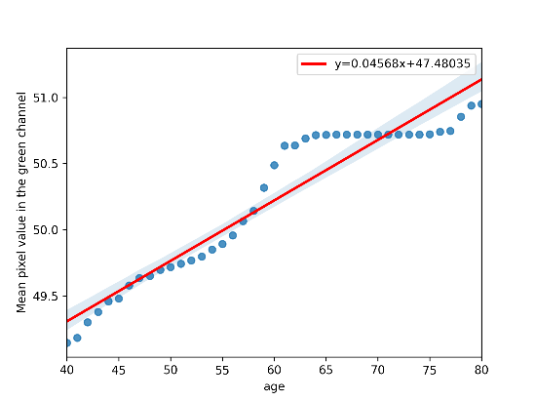
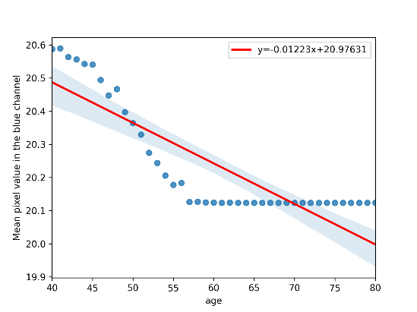
Experiment and results -> Counterfactual inference
Model the causation towards an individual observation under a counterfactual condition
Fig 33: Linear Regression of the mean pixel value in the red channel on age
Fig 34: Linear Regression of the mean pixel value in the green channel on age
Fig 35: Linear Regression of the mean pixel value in the blue channel on age
Notes:
Exclude

Slide 38
Contents
Background
Preliminary
Research question
Methodology
Experiment and results
Conclusion
Future work
Notes:
delete

Slide 39
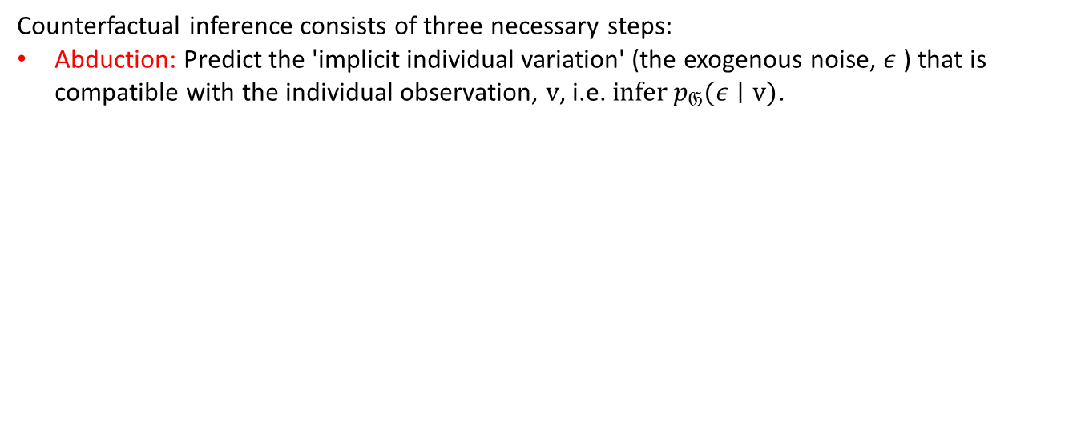
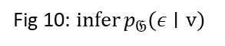
Preliminary -> Counterfactual inference
Counterfactual inference consists of three necessary steps:
Abduction: Predict the 'implicit individual variation' (the exogenous noise, $ε$ ) that is compatible with the individual observation, $v$, i.e. $infer⁡p_{𝔊}(ε∣v)$.
Fig 9: A toy linear SCM
Fig 10: $infer⁡p_{𝔊}(ε∣v)$

Slide 40
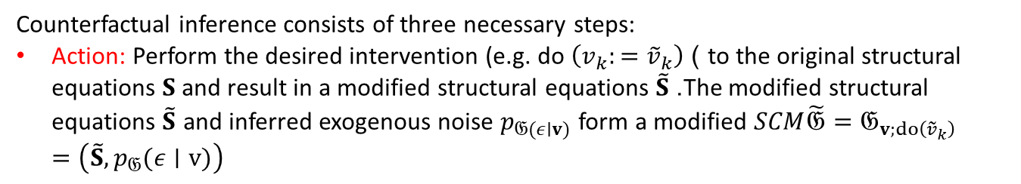
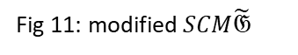
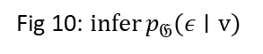
Preliminary -> Counterfactual inference
Counterfactual inference consists of three necessary steps:
Action: Perform the desired intervention (e.g. do $\left(v_{k}:={\tilde{v}}_{k}\right)$ ) to the original structural equations $S$ and result in a modified structural equations $\tilde{S}$. The modified structural equations $\tilde{S}$ and inferred exogenous noise $p_{𝔊(ε∣v)}$ form a modified $SCM\tilde{𝔊}=𝔊_{v;do⁡\left({\tilde{v}}_{k}\right)}=\left(\tilde{S},p_{𝔊}(ε∣v)\right)$
Fig 10: $infer⁡p_{𝔊}(ε∣v)$
Fig 11: modified $SCM\tilde{𝔊}$

Slide 41

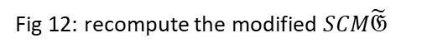
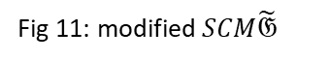
Preliminary -> Counterfactual inference
Counterfactual inference consists of three necessary steps:
Prediction: Compute the value of interested variables $v_{i}∈v$ based on the modified SCM $\tilde{𝔊}$.
Fig 11: modified $SCM\tilde{𝔊}$
Fig 12: recompute the modified $SCM\tilde{𝔊}$

Slide 42
Methodology
Deep Structural Causal Model(DSCM) on fundus image
Fig 13: Assumed causal DAG
Fig 14: custom DSCM

Slide 43
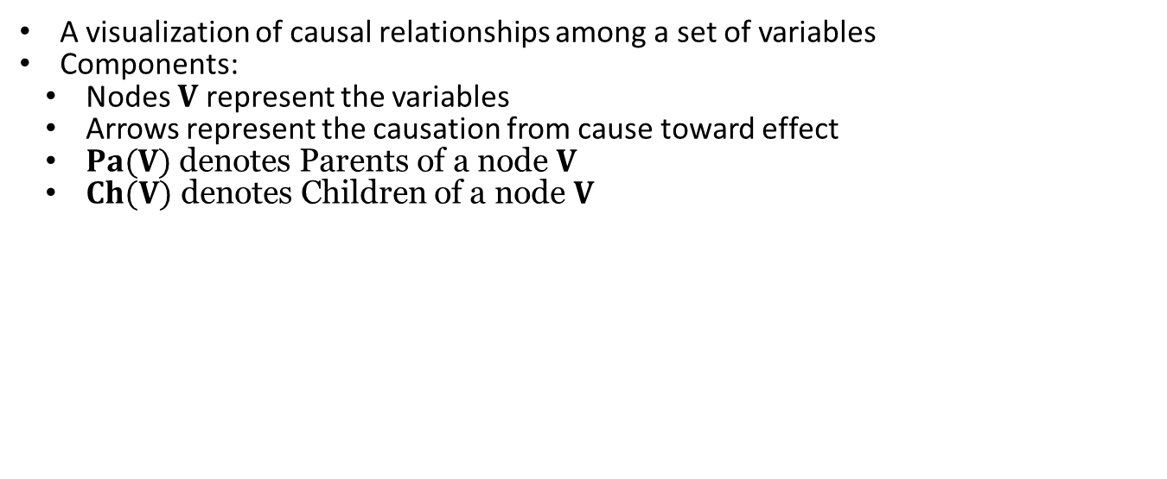
Preliminary -> causal DAG(directed acyclic graph)
A visualization of causal relationships among a set of variables
Components:
Nodes $V$ represent the variables
Arrows represent the causation from cause toward effect
$Pa(V)$ denotes Parents of a node $V$
$Ch(V)$ denotes Children of a node $V$
Fig 5: A toy causal DAG

Slide 44
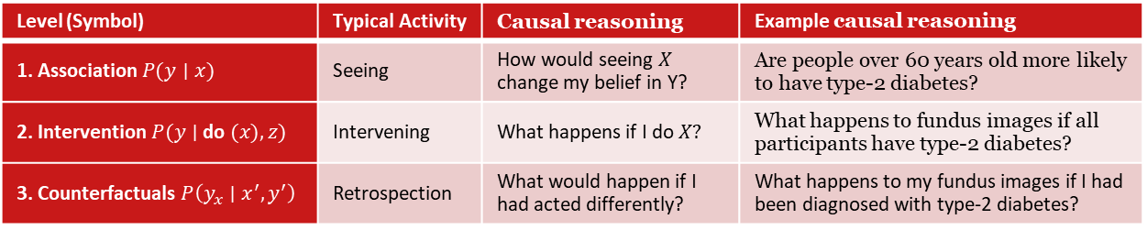
Preliminary -> Causal hierarchy
Level (Symbol) | Typical Activity | Causal reasoning | Example causal reasoning
1. Association $P(y∣x)$ | Seeing | How would seeing $X$ change my belief in Y? | Are people over 60 years old more likely to have type-2 diabetes?
2. Intervention $P(y∣$ do $(x),z)$ | Intervening | What happens if I do $X?$ | What happens to fundus images if all participants have type-2 diabetes?
3. Counterfactuals $P\left(y_{x}∣x^{′},y^{′}\right)$ | Retrospection | What would happen if I had acted differently? | What happens to my fundus images if I had been diagnosed with type-2 diabetes?
Association
Introduce Causation
Block the non-causal association(confounding)
Intervention
Introduce exogenous noise presenting implicit individual variation
Infer on individual level to avoid heterogeneity
Counterfactuals

Slide 45
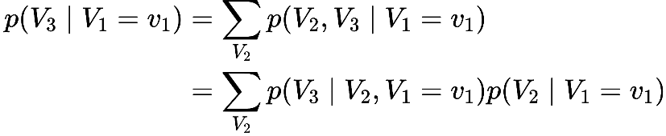
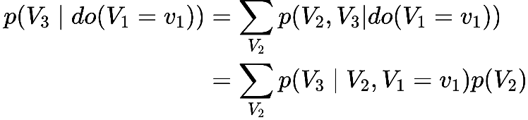
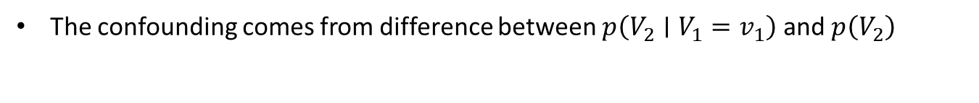
Preliminary -> Intervention and Causal Bayesian Network
The confounding comes from difference between $p\left(V_{2}∣V_{1}=v_{1}\right)$ and $p\left(V_{2}\right)$
Associational inference
Interventional inference
Fig 6: A causal Bayesian Network
Fig 7: A causal Bayesian Network after intervention

Slide 46
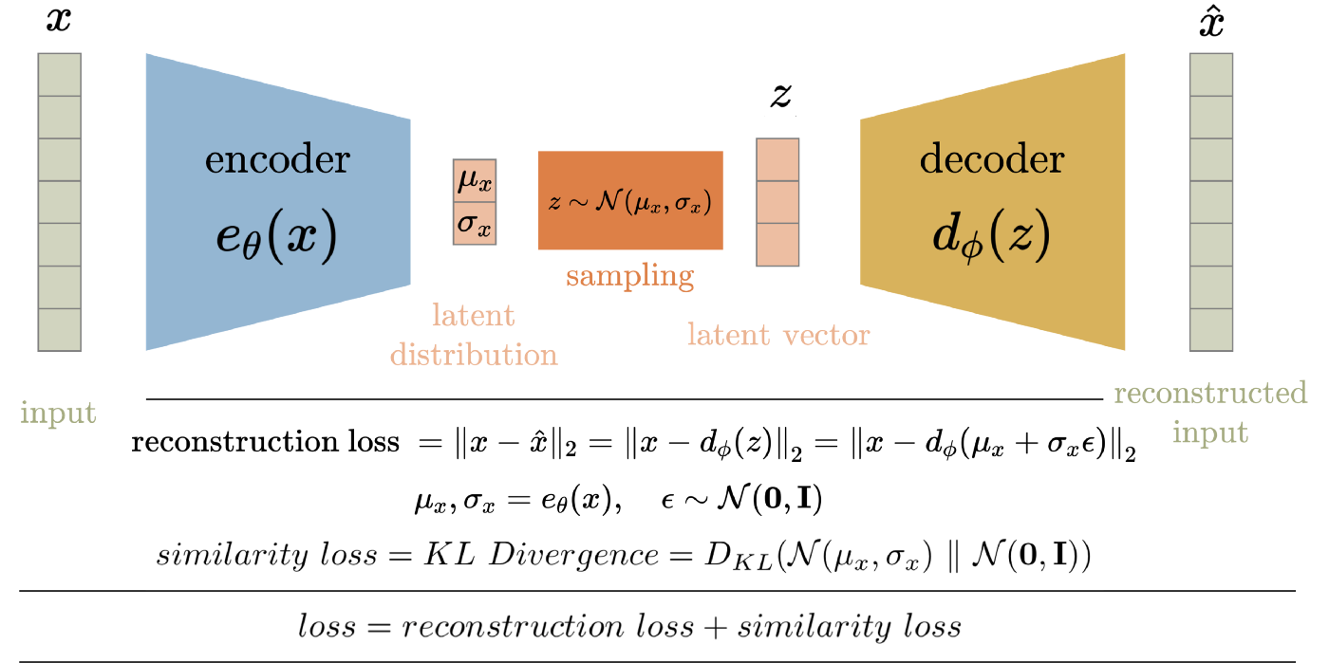
Preliminary -> Generative model
Variational Auto-Encoder(VAE)

Slide 47



Preliminary -> Generative model
Normalising flow
A normalizing flow models data $x$ as the output of an invertible, differentiable monotonic transformation $f$ of noise $u$ :
$x=f(u)$ where $u∼π(u)$
The probability density of x under the flow:
$$p(x)=π\left(f^{−1}(x)\right)\left|det⁡\left(\frac{∂f^{−1}}{∂x}\right)\right|$$
Example: spline flow transformation

Slide 48

Preliminary -> Counterfactual inference
Abduction: Predict the 'state of the world' (the exogenous noise,$ε_{k}$) that is compatible with the observations, $x_{k}$, i.e. infer $P_{𝔊}(ε_{k}∣x_{k})$ by $ε_{k}=f_{k}^{−1}\left(x_{k};{pa}_{k}\right)$.
Action: Perform an intervention (e.g. do $\left.\left(x_{k}:={\tilde{x}}_{k}\right)\right)$ corresponding to the desired manipulation, resulting in a modified SCM $\tilde{𝔊}=𝔊_{x;do⁡\left({\tilde{x}}_{k}\right)}=\left(\tilde{S},P_{𝔊}(ε∣x)\right)$.
Prediction: Compute the quantity of interest based on the distribution entailed by the counterfactual SCM, $P_{\tilde{𝔊}}(x)$
Abduction
Action
Prediction

Slide 49

Preliminary -> Generative model
Normalising flow
A normalizing flow models data $x$ as the output of an invertible, differentiable monotonic transformation $f$ of noise $u$ :
$x=f(u)$ where $u∼π(u)$
The probability density of x under the flow:
$$p(x)=π\left(f^{−1}(x)\right)\left|det⁡\left(\frac{∂f^{−1}}{∂x}\right)\right|$$
Given a dataset $𝒟={\left\{x^{(n)}\right\}}_{n=1}^{N}$, loss = ${−∑}_{n} log⁡p\left(x^{(n)}\right)$
Example: spline flow transformation

Slide 50
Preliminary -> Generative model
Variational Auto-Encoder(VAE)

Slide 51
Methodology
Deep Structural Causal Model on fundus image
Composable independent trainable mechanisms

Slide 52







Methodology -> Patient attributes
$$S∽ \text{Bernoulli} \left(logit_{S}\right)$$
Note: S has prior $logit_{S}$=0 but no exogenous noise
----------------------------------------------------------------------------------------------------------------
$a:=f_{A}\left(ε_{A}\right)=\left(Exp∘\right.$AffineNormalisation$∘$Spline$\left. _{θ}\right)\left(ε_{A}\right)$
AffineNormalisation:
$Exp$:
----------------------------------------------------------------------------------------------------------------
$$d:=f_{D}\left(ε_{D}\right)=\left({\text{Gumbe}\text{l}\text{−}\text{max} }_{λ }([s,\overset{ˆ}{a}])\right)\left(ε_{D}\right)$$
$ε_{D}∼ \text{Gumbel} (0,1)$
$λ$：= Dense$\left(\left[s,\overset{ˆ}{a}\right]\right)$
${\text{Gumbe}\text{l}\text{−}\text{max} }_{λ } : \underset{1≤l≤K}{arg⁡max}\left(ε_{D}^{l}+λ_{l}\right), ε_{D}^{l}∼Gumbel⁡(0,1)$

Slide 53



Methodology -> Image
$$h_{X}\left(u_{X};{pa}_{X}\right)=\left[ \text{Preprocessing} ∘{ \text{ConditionalAffine} }_{θ}\left(\hat{age},s,\hat{d},z_{X}\right)\right]\left(u_{X}\right)$$
$u_{X}∼ \text{Gaussian} (0,1)$
$\text{Preprocessing}$: Affinetransform(-0.5, 1/256), [0, 256] ->[-0.5, 0.5]
${\text{ConditionalAffine} }_{θ}$:
----------------------------------------------------------------------------------------------------------------
Pixel-level detail preserved
Abduction
Prediction
Difference

Slide 54


Appendix -> VAE structure
$\begin{matrix}e_{X}\left(x;{pa}_{X}\right)= & \left(\left[{Linear}_{θ}⁡(latent_dim),{Linear}_{θ}⁡(latent_dim)\right]∘\left[LeakyReLU⁡(0.1),{\hat{pa}}_{X}\right]\right. \\ & ∘{BN}_{θ}∘{Linear}_{θ}⁡(latent_dim)∘Reshape⁡(128⋅4⋅4) \\ & \left(\begin{matrix}∘LeakyReLU⁡(0.1)∘{BN}_{θ}∘{Conv}_{θ}⁡(filter;4;2,1) \\ \left.∘LeakyReLU⁡(0.1)∘{BN}_{θ}∘{Conv}_{θ}⁡(filter;3;1,1\right) \\ \left.∘LeakyReLU⁡(0.1)∘{BN}_{θ}∘{Conv}_{θ}⁡(filter;3;1,1\right)\end{matrix}\right))(x)\end{matrix}$
$filter$ in filters([16, 24, 32, 64, 128])
$z_{X}∼ \text{Gaussian} (0, 1)$, size of 128
Note: encoder, latent_encoder, x.shape=(3, 128, 128) after subsample of 4
$g_{X}\left(z_{X};{pa}_{X}\right)=\left(\left[{Conv}_{θ}⁡(3;1;1;0),{Conv}_{θ}⁡(3;1;1;0)\right]∘{Conv}_{θ}⁡(3;1;1;0)\right.$ $\left(\begin{matrix}∘ \text{LeakyReLU}\text{(}\text{0.1}\text{)} ∘{BN}_{θ}∘{ConvTranspose }_{θ}⁡( \text{filter}\text{_}\text{next}\text{; }\text{4}\text{; }\text{2,1}\text{)} \\ ∘ \text{LeakyReLU} (0.1)∘{BN}_{θ}∘{Conv}_{θ}⁡( \text{filter}\text{; }\text{3}\text{; }\text{1,1}\text{)} \\ ∘ \text{LeakyReLU}\text{(}\text{0.1}\text{)} ∘{BN}_{θ}∘{Conv}_{θ}⁡( \text{filter}\text{; }\text{3}\text{; }\text{1,1}\text{)} \end{matrix}\right)$
$$\text{o} \text{Reshape}\text{ (}\text{128}\text{,}\text{8}\text{,}\text{8}\text{) }\left.∘ReLU∘{BN}_{θ}∘{Linear}_{θ}⁡(8192)\right)\left(\left[{\hat{Z}}_{X},{\hat{pa}}_{X}\right]\right)$$
filters([128, 64, 32, 24]), $\text{filter}\text{_}\text{next}$([, 64, 32, 24, 16])
$z_{X}∼ \text{Gaussian} (0, 1)$, size of 128
Note: decoder, encoder toward affinetransformation, output.shape=[(batch, 3, 128, 128), (batch, 3, 128, 128)] as (loc, scale)

Slide 55


Appendix -> Pixel-level detail preserved
Consider an uncorrelated Gaussian decoder for images as a concrete example, predicting vectors of means and variances for each pixel of $x_{k}:g_{k}\left(z_{k};{pa}_{k}\right)=\left(μ\left(z_{k};{pa}_{k}\right),σ^{2}\left(z_{k};paa_{k}\right)\right)$, with the lowlevel reparametrisation given by $h_{k}\left(u_{k};\left(μ,σ^{2}\right),{pa}_{k}\right)=μ+σ^{2}⊙u_{k}$. Exploiting the reparametrisation trick, counterfactuals that preserve $x_{k}$ 's mechanism can be computed simply as
where $⊘$ and $⊙$ denote element-wise division and multiplication, respectively. In particular, in the constant-variance setting adopted for our experiments, counterfactuals further simplify to
$${\tilde{x}}_{k}^{(s)}=x_{k}+\left[μ\left(z_{k}^{(s)};\tilde{{pa}_{k}}\right)−μ\left(z_{k}^{(s)};{pa}_{k}\right)\right]$$

Slide 56



Experiment Result -> Original fundus
Model reconstruction(only color is captured)
Model conditional sampling
Model unconditional sampling
Notes:
000046220120416010001.tiff

Slide 57



Experiment Result -> Segmented fundus
Model reconstruction(only color is captured)
Model conditional sampling
Model unconditional sampling
(Sex, T2D) (0,0) (0,1) (1,0) (1,1)
Notes:
000046220120416010001.tiff

Slide 58

Experiment Result -> Segmented fundus
Counterfactual inference
Notes:
000046220120416010001.tiff

Slide 59

Experiment Result -> Segmented fundus
Original
Recon
Counterfactual Age =40
Counterfactual Age =60
Counterfactual Age =80
Notes:
000046220120416010001.tiff

Slide 60

Preliminary -> Intervention and Causal Bayesian Network
Intervention models the causation by intervening on the causal DAG
causal Bayesian network
In a DAG, every parent is a direct cause of all its children
Given the intervention on a set of nodes $V_{W}$, setting them to constants. Then we have the following modifications to the probability distribution.
For all intervened nodes $V_{i}∈V_{W}$, set $p\left(v_{i}∣Pa\left(V_{i}\right)\right)$ to 1 if $v_{i}$ is equal to the set value by intervention and set $p\left(v_{i}∣Pa\left(V_{i}\right)\right)$ to 0 if not.
The unintervened nodes $V_{i}∉V_{W}$ keep the same $p\left(V_{i}∣Pa\left(V_{i}\right)\right)$.

Slide 61

Preliminary -> Counterfactual inference
Abduction: infer $P_{𝔊}(ε_{k}∣x_{k})$ by $ε_{k}=f_{k}^{−1}\left(x_{k};{pa}_{k}\right)$.
Action: Perform an intervention (e.g. do $\left.\left(x_{k}:={\tilde{x}}_{k}\right)\right)$ resulting in a modified SCM $\tilde{𝔊}=𝔊_{x;do⁡\left({\tilde{x}}_{k}\right)}=\left(\tilde{S},P_{𝔊}(ε∣x)\right)$.
Prediction: Compute $P_{\tilde{𝔊}}(x)$
Abduction
Action
Prediction

Slide 62
Future work
As our assumption on the causal DAG is bold, we expect to include more associated patient attributes and make a reasonable and convincing causal DAG based on the research finding on their relationships.
Improve the fundus image quality by filtering out the occluded and not centered on optic disc. Also by merging other dataset.
Adopt alternative causal model architecture supporting counterfactual inference, like ImageCFGen
Notes:
000046220120416010001.tiff

